Slide 1

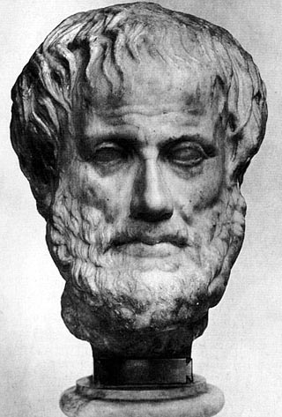
Virtue Ethics
Michael Lacewing
enquiries@alevelphilosophy.co.uk
© Michael Lacewing

Slide 2
Virtue ethics
Ethics isn’t just about acting, but about living
An action is right if and only if it is what a virtuous agent would characteristically (i.e. acting in character) do in the circumstances
  Knowing how to act takes practical wisdom, which involves experience and insight

Slide 3
What is a virtue?
Aristotle: a virtue is a state of character by which you ‘stand well’ in relation to your desires, emotions and choices:
  ‘to feel [desires and emotions] at the right times, with reference to the right objects, towards the right people, with the right motive, and in the right way’
Virtues are traits that are necessary for ‘living well’.

Slide 4
Practical wisdom
Aristotle: ‘a true and reasoned state of capacity to act with regard to the things that are good or bad for man’
  a general conception of what is good or bad (conditions for human flourishing);
  the ability to perceive, in light of that general conception, what is required in terms of feeling, choice, and action in a particular situation;
  the ability to deliberate well; and
  the ability to act on that deliberation.

Slide 5
Contextualism
There are no true generalizations about right and wrong – practical wisdom is a form of intuitive reason.
But ethics is not subjective; it is ‘context-sensitive’.
Practical wisdom cannot be taught, but must be acquired through experience.

Slide 6
The doctrine of the mean
Virtues and virtuous actions lie between ‘intermediate’ between two vices of ‘too much’ and ‘too little’
      E.g. being good-tempered
But this is not the same as ‘moderation’ on all occasions
      E.g. not moderate anger, but anger appropriate to the situation
Not arithmetical – corresponding vices aren’t always ‘too much’ or ‘too little’
  E.g. honesty v. tactlessness v. deception

Slide 7
Objections
Not everyone can know what is right
  Is this a strong objection? If there is any moral knowledge, why assume everyone has it?
The doctrine of the mean is useless
Virtue ethics provides no guidance
  Ask a virtuous person
  Frame questions in terms of virtues
Can virtues conflict?
Is there an objective truth about what it takes to ‘live well’?

